Slide 2
Netflix Clone
Submitted by:
Anushka Patel
0827CS211030

Slide 3
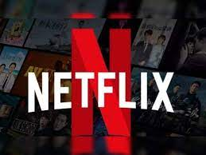
Introduction
Thank you for joining us today as we delve into the development of Streamify. In a landscape dominated by streaming giants, Streamify aims not only to mirror Netflix's success but to redefine the streaming experience. Together, we'll navigate the intricacies of building a platform that captures the essence of entertainment in a unique and engaging way.

Slide 4
Project Overview
Streamify isn't just another Netflix look-alike; it's a carefully crafted project that blends technology, creativity, and user-centric design. Using a powerful tech stack, including HTML, CSS, JavaScript, and Bootstrap, Streamify promises a seamless streaming experience with a touch of innovation. Let's dive into the details of what makes Streamify stand out in the world of streaming platforms.

Slide 5
Technologies used
At the core of Streamify lies a robust tech stack. HTML provides the structural foundation, CSS adds style, and JavaScript brings interactivity to life. These technologies synergize to create a modern, dynamic, and user-friendly Netflix Clone.

Slide 6
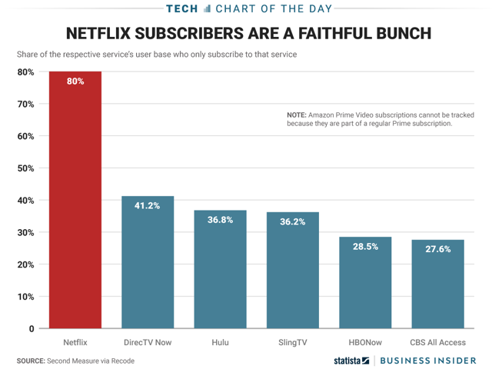
User engagement focus
User engagement is our North Star. Beyond the code and design, Streamify is about creating an experience that resonates with users, keeping them captivated and involved. In this section, we'll delve into the strategies and features designed to enhance user engagement on Streamify.

Slide 7
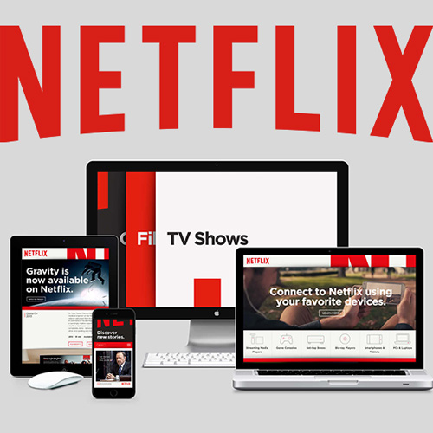
Responsive design
A seamless user experience across devices is non-negotiable. Streamify's responsive design ensures a consistent and enjoyable experience on desktops, tablets, and smartphones. Discover how our commitment to responsive design enhances accessibility and usability for all users.

Slide 8
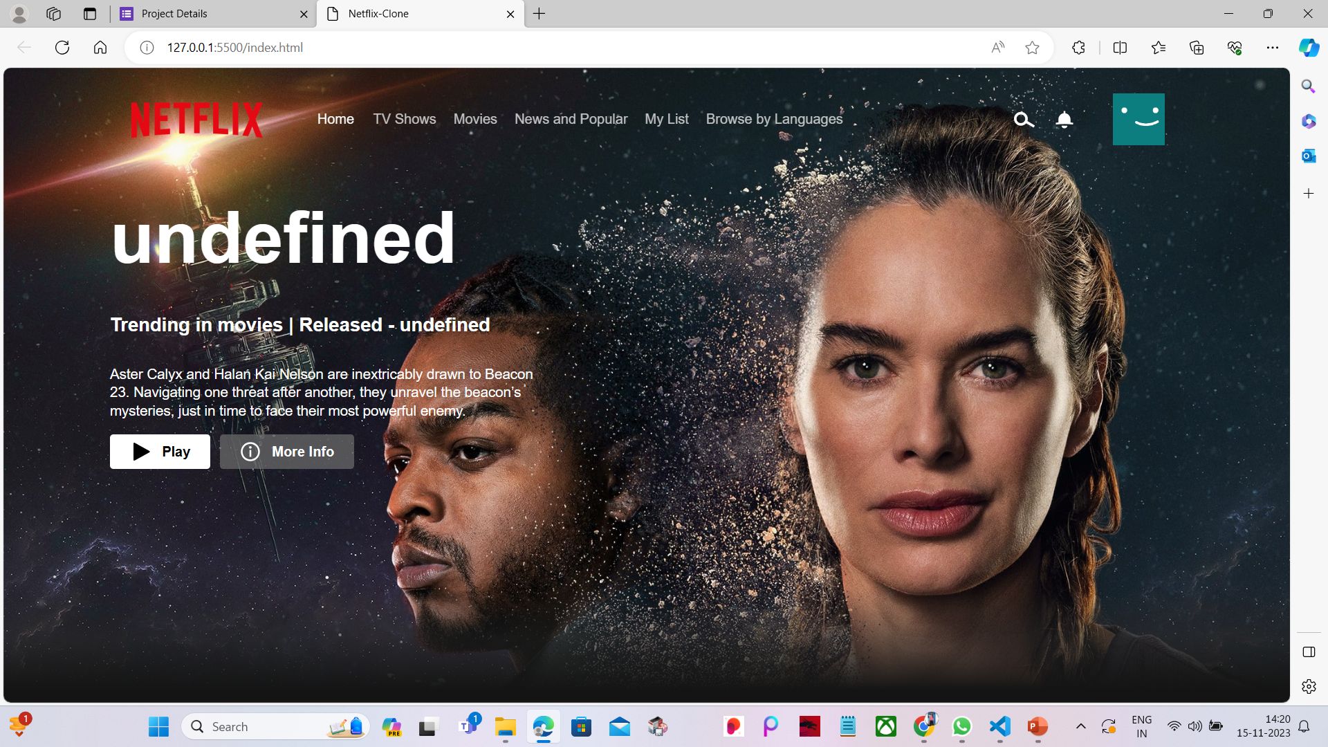
User Interface

Slide 9
Q&A

Slide 10
THANKS

